Slide 1
The Case for Inclusion 2024
Transforming Temporary Progress into Long-Term Sustainability

Slide 2
Housekeeping
This webinar is being recorded; the recording will be shared with registrants within three business days.
Use the Q&A feature in the Zoom control panel to ask questions of today’s speakers.
Use the Chat feature in the Zoom control panel to connect with event organizers if you experience technical difficulties.
Closed captioning is available; click on the ‘CC’ icon in the Zoom control panel to see closed captioning.

Slide 3
Today’s Agenda
Opening Remarks
Key Findings Data
From the Field: Panel Discussion
Policy Blueprint for Sustainable Services
Audience Q&A
Closing Remarks

Slide 4
Opening Remarks
Armando Contreras
President & CEO
United Cerebral Palsy (UCP)

Slide 5
Key Findings Data
Lydia Dawson, ANCOR

Slide 6
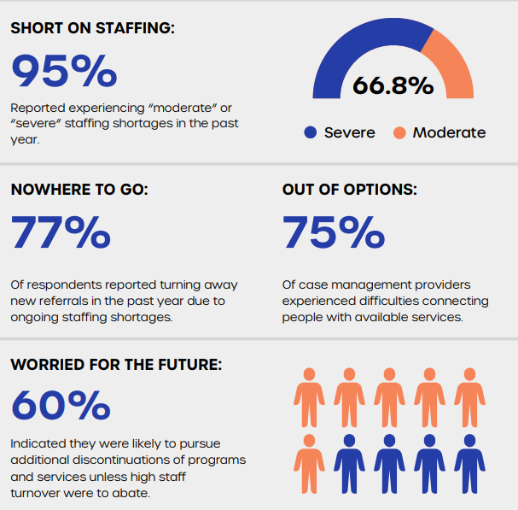
The State of America’s Direct Support Workforce Crisis 2023
Notes:
83% of providers are turning away new referrals, representing a 25.8% pre-pandemic increase;
63% of providers are discontinuing programs and services, representing a 85.3% increase since the beginning of the pandemic; and
55% of providers are considering additional service discontinuations.
Another 37% indicated they were not sure,
Only 8% responded they would not.

Slide 7
Temporary Measures Foster Hope for Permanent Solutions
Hourly wage for direct support professionals (DSP) wages increased from $13.61 in 2020 to $14.41 in 2021.
Vacancy rates for both full- and part-time DSP positions increased substantially, with full-time vacancy rates increasing to 16.5% and part-time vacancy rates increasing to 20.3%.
Nationally, there were 497,354 people with I/DD on state waiting lists for home- and community-based services (HCBS) waivers.

Slide 8
Temporary Measures Foster Hope for Permanent Solutions
17 states + DC have closed all their public residential facilities (PRFs), state-run facilities housing sixteen or more people with I/DD.
38 states participated in the federal Money Follows the Person program, ear-marked to support the transition from institutions to HCBS.
18 demonstration waivers that include initiatives to address social determinants of health have been approved, with 17 more pending.

Slide 9
From the Field: Panel Discussion
Kentay Garvin, UCP of Central Arizona
Rachel Neumann, COF Training Services
Grey Persons, Hope House Foundation
James Garcia, UCP (moderator)

Slide 10
Policy Blueprint for Sustainable Services
Elise Aguilar, ANCOR

Slide 11
Recommendations for the Biden Administration
Require states to establish systems of access monitoring that compel regular reviews of Medicaid reimbursement rates.
Encourage interagency collaboration between the U.S. Department of Health & Human Services, U.S. Department of Labor, and other federal agencies to ensure that policies that will result in and direct appropriate funding for community providers are in place prior to any significant increase in expense to service delivery.

Slide 12
Recommendations for the Biden Administration
Require state and federal agencies to collect and publicly report on measures related to direct support workforce volume, stability and compensation, as well as measures that address systemic barriers to equity, support for underserved communities, and the delivery of culturally competent services.
Examine existing programs that support health-related social needs for people with IDD and the direct support workforce to better ensure access to health care and promote economic independence.

Slide 13
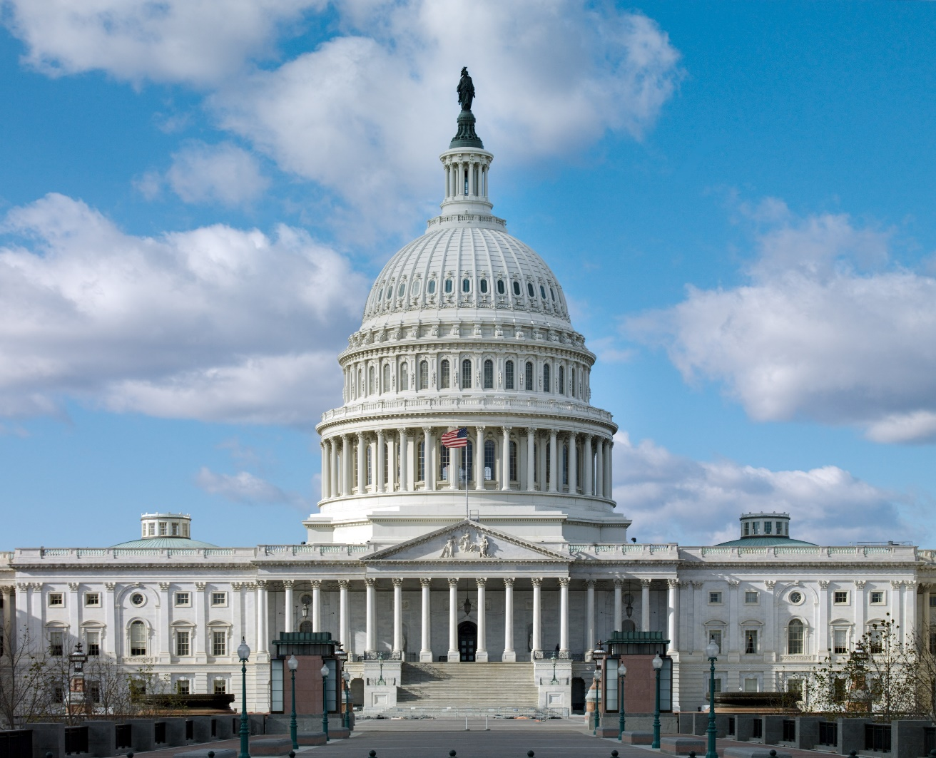
Recommendations for the 118th Congress
Enact legislation to significantly increase the federal share of Medicaid funding for HCBS to stabilize the direct support workforce and require states to regularly review Medicaid reimbursement rates.
Continue investing in HCBS through the American Rescue Plan Act and extend the increased federal match for states with existing maintenance of effort provisions.
Urge the U.S. Office of Management & Budget to establish a Standard Occupational Classification (SOC) for DSPs.

Slide 14
Recommendations for the 118th Congress
Enact legislation that would fund federal grant programs to support the training, recruitment, retention and advancement of the direct support workforce.
Examine existing policies and expand opportunities to provide immigrants living in the United States with work authorizations and create pathways for aspiring Americans interested in joining the direct support workforce.

Slide 15
Recommendations for States
Support and leverage as many opportunities as possible to secure additional funding from the federal government to strengthen the direct support workforce, while also considering policies that expand access to services.
Establish systems that provide regular review of Medicaid reimbursement rates.

Slide 16
Recommendations for States
Participate in the National Core Indicators’ annual State of the Workforce Survey and other data collection efforts assessing the direct support workforce.
Collect and publicly report on measures related to direct support workforce volume, stability, and compensation, as well as measures that address systemic barriers to equity, support for underserved communities, and the delivery of culturally competent services within the direct support workforce.

Slide 17
What You Should Do
Visit the Case for Inclusion 2024 website at caseforinclusion.org to access stories, data and other resources beyond the key findings report to aid in your advocacy
Use the ANCOR Amplifier at amplifier.ancor.org to lend your voice to calls on our elected officials to take meaningful action in service of this shared vision
Connect with a UCP Affiliate in your community at UCP.org to see how you can get involved at a local level

Slide 18
Questions?

Slide 19
Closing Remarks
Barbara Merrill
Chief Executive Officer
ANCOR

